Slide 1


Zero-Query Adversarial Attack
on Black-box Automatic Speech Recognition Systems
PhilFan
www.philfan.cn
1st Nov 2024

Slide 2
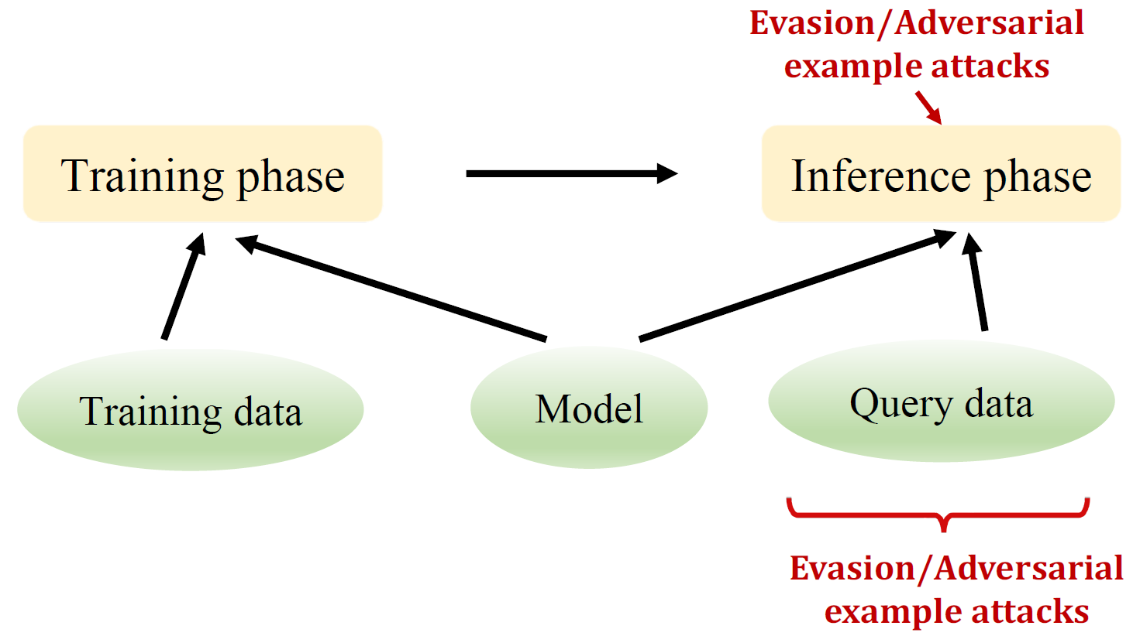
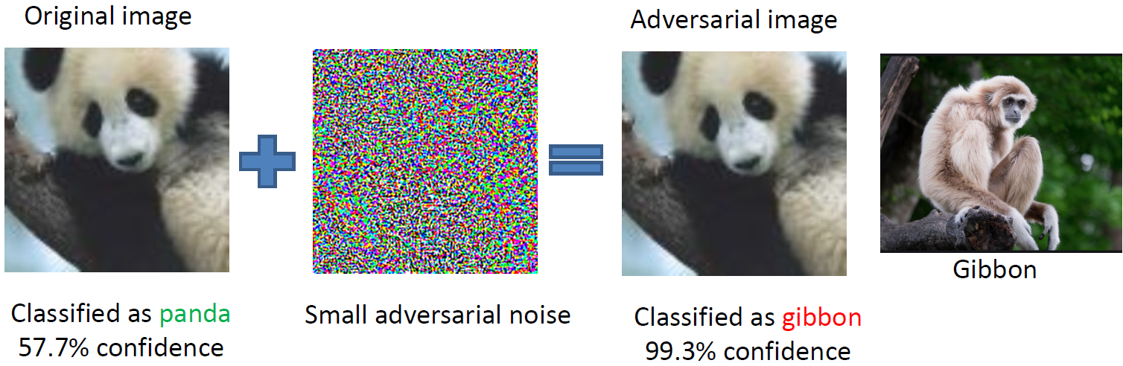
Terminology Technical Route Results
Zero-Query Adversarial Attack on Black-box
Automatic Speech Recognition Systems
Adversarial Attack: change behavior to avoid detection
PhilFan
1st Nov 2024
Notes:
所谓对抗样本就是指：在原始样本添加一些人眼无法察觉的扰动（这样的扰动不会影响人类的识别，但是却很容易愚弄模型），致使机器做出错误的判断。

Slide 3
Terminology Technical Route Results
Zero-Query Adversarial Attack on Black-box
Automatic Speech Recognition Systems
White-box attack
– Attackers have full knowledge about the ML model.
Black-box attack
– Attackers don’t have access to the ML model parameters, gradients,architecture
– Know about used ML algorithm
– Zero-Query:Don’t get query samples and query results
PhilFan
1st Nov 2024

Slide 4
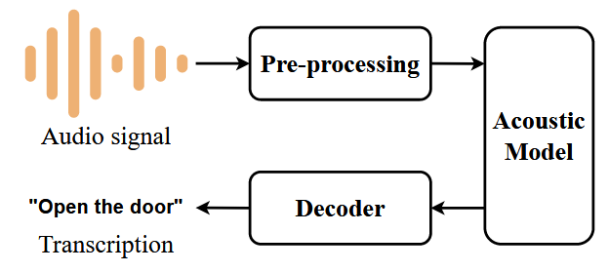






Terminology Technical Route Results
Zero-Query Adversarial Attack on Black-box
Automatic Speech Recognition Systems
spoken language
text
Online Speech Recognition
Target
System
Commercial IVC
Open-source ASRs
Jasper QuartzNet, ContextNet (M/L) ，Citrinet (M/L）……
PhilFan
1st Nov 2024

Slide 5


Difficulties in Audio Adversarial Attacks
Terminology Technical Route Results
The target model is a black box, with no access to its structure, parameters, or training data. When using the target model for image classification, typically only a single label is provided without accuracy information. Additionally, API query limits impose cost constraints and potential detection by platform anomaly programs.
Speech systems must handle temporal information changes, which is more complex than image classification. Audio sampling rates are usually high (e.g., 16kHz, implying 16,000 samples per second), whereas images have only hundreds or thousands of pixels (e.g., 28×28 for MNIST and 32×32 for CIFAR-10).
PhilFan
1st Nov 2024

Slide 6
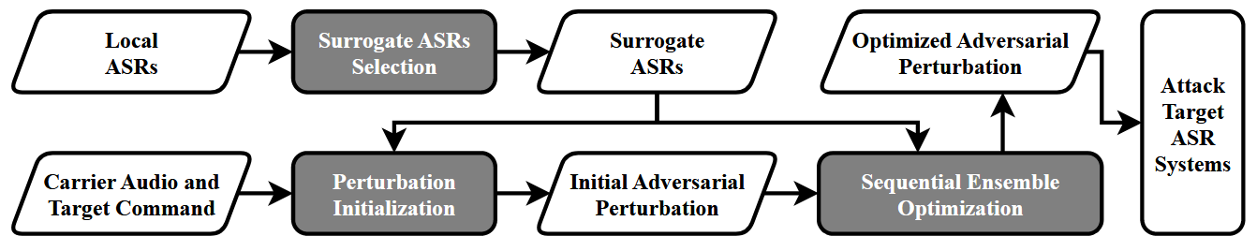
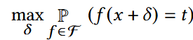
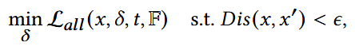
Terminology Technical Route Results
Workflow & Loss Function
PhilFan
1st Nov 2024

Slide 7

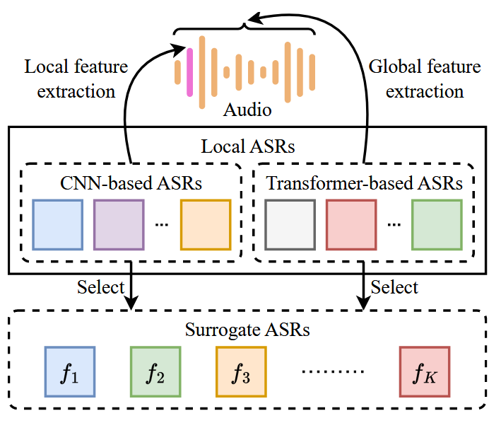

Terminology Technical Route Results
Surrogate ASRs Selection
Local features
Global information
CNNs
Transformers
Incorporate both CNN-based and Transformer-based ASRs
PhilFan
1st Nov 2024

Slide 8

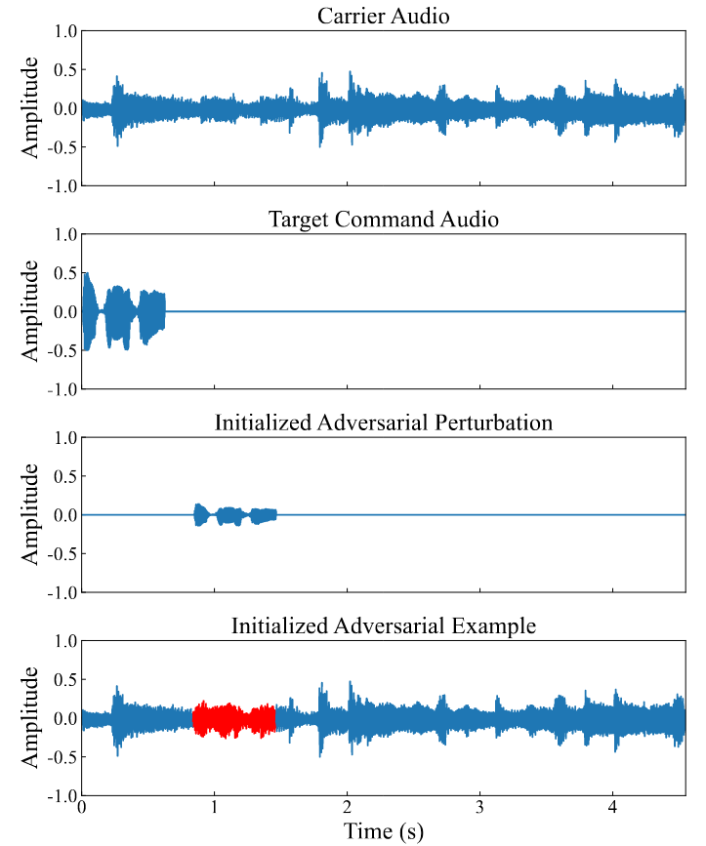
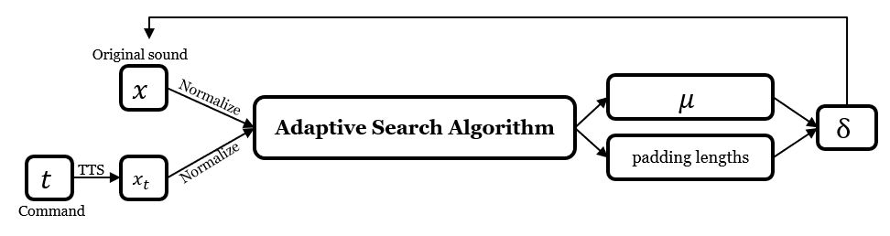





Pertubation Initialization
Terminology Technical Route Results
According to the algorithm, I draw this map to help us to understand
the adaptive search algorithm initializes δ by pushing adversarial example toward the decision boundary of all surrogate ASRs, thereby circumventing the time consuming and uncertain initial search process.
PhilFan
Original sound
$$x$$
$$μ$$
Normalize
Adaptive Search Algorithm
$$δ$$
Normalize
padding lengths
$$t$$
TTS
$$x_{t}$$
Command

Slide 9
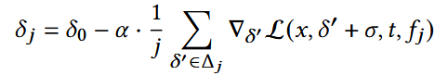
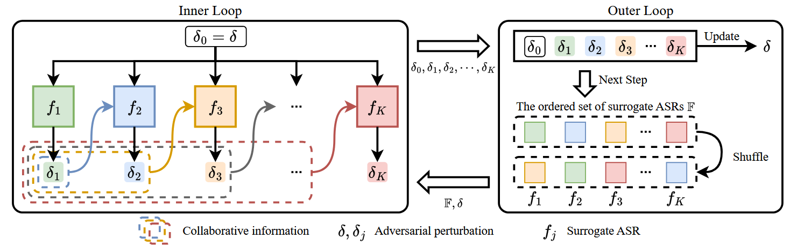
Terminology Technical Route Results
Sequential Ensemble Optimization
Inner Loop
Updating one-by-one
restrict the updated δj within a limited range
Outer Loop
Update δ
Shuffle the set of surrogate ASRs
considers both current & preceding surrogate ASRs.
PhilFan
1st Nov 2024

Slide 10
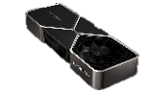


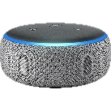
Experiment Design
Terminology Technical Route Results
Hardware
Geforce 3080Ti ×8
Intel Xeon Gold 5117 ×2
iPhone 13
Amazon Echo Dot
Over-the-line: Carlini,Occam,KENKU.
Over-the-air: NI-Occam and KENKU.
Baseline
SRoA & SNR
PhilFan
1st Nov 2024

Slide 11
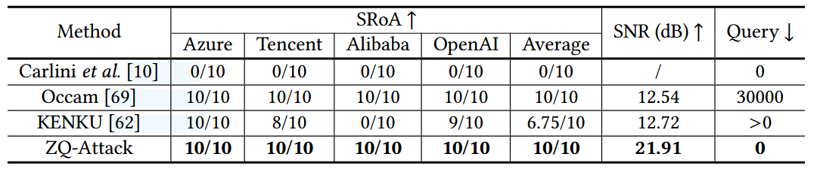
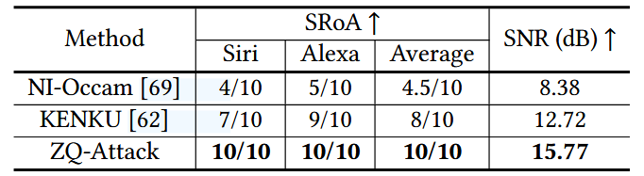
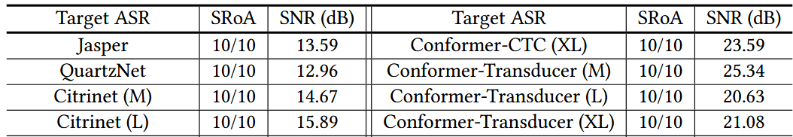
Data
Terminology Technical Route Results
Online Speech Recognition
Commercial IVC
Open-source ASRs
PhilFan
1st Nov 2024

Slide 12
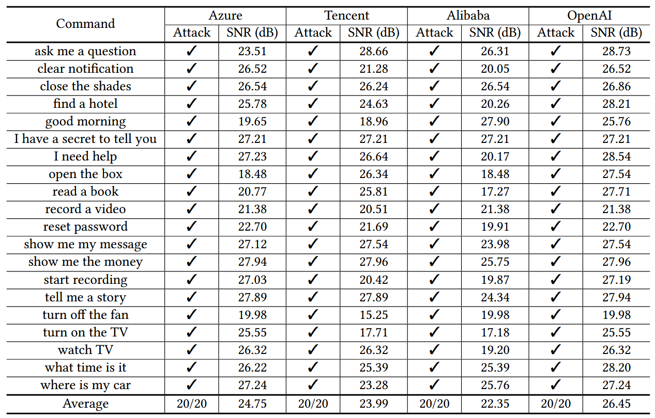
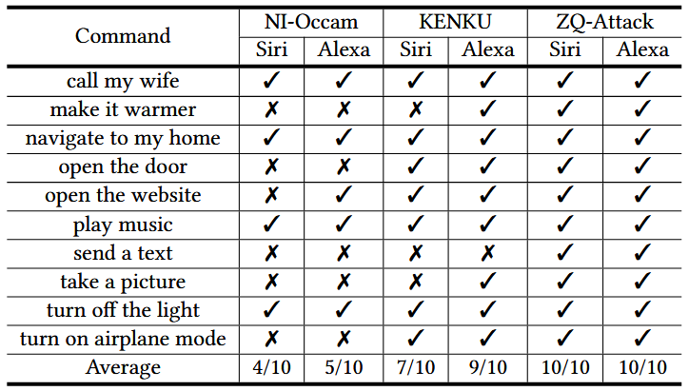
Data
Terminology Technical Route Results
Evaluation on a large command set
PhilFan
1st Nov 2024

Slide 13
提纲 项目背景 技术路线 项目规划
Thanks
PhilFan
1st Nov 2024

